Slide 1
Groupby, Working with Text data, Creating Panda Series, Merging, Joining, Concatenation

Slide 2
Groupby
Groupby is a pretty simple concept.
We can create a grouping of categories and apply a function to the categories.
It’s a simple concept but it’s an extremely valuable technique that’s widely used in data science.
In real data science projects, you’ll be dealing with large amounts of data and trying things over and over, so for efficiency.
We use Groupby concept. Groupby concept is really important because it’s ability to aggregate data efficiently, both in performance and the amount code is magnificent.

Slide 3
Groupby mainly refers to a process involving one or more of the following steps they are:
Splitting : It is a process in which we split data into group by applying some conditions on datasets.
Applying : It is a process in which we apply a function to each group independently
Combining : It is a process in which we combine different datasets after applying groupby and results into a data structure

Slide 4
Grouping data with one key:
In order to group data with one key, we pass only one key as an argument in groupby function.
import pandas as pd
data1 = {'Name':['Jai', 'Anuj', 'Jai', 'Princi',
'Gaurav', 'Anuj', 'Princi', 'Abhi'],
'Age':[27, 24, 22, 32,
33, 36, 27, 32],
'Address':['Nagpur', 'Kanpur', 'Allahabad', 'Kannuaj',
'Jaunpur', 'Kanpur', 'Allahabad', 'Aligarh'],
'Qualification':['Msc', 'MA', 'MCA', 'Phd',
'B.Tech', 'B.com', 'Msc', 'MA']}
df = pd.DataFrame(data1)
print(df)

Slide 5
Now we print the first entries in all the groups formed.
gk = df.groupby('Name')
gk.first()
Grouping data with Multiple Keys
df.groupby(['Name', 'Qualification'])
print(df.groupby(['Name', 'Qualification']).groups)
df.groupby(['Name']).sum()
Iterating element of group
grp = df.groupby('Name')
for name, group in grp:
print(name)
print(group)
print()

Slide 6
Selecting a Group
grp = df.groupby('Name')
grp.get_group('Jai’)
Aggregation
import pandas as pd
import numpy as np
data1 = {'Name':['Jai', 'Anuj', 'Jai', 'Princi',
'Gaurav', 'Anuj', 'Princi', 'Abhi'],
'Age':[27, 24, 22, 32,
33, 36, 27, 32],
'Address':['Nagpur', 'Kanpur', 'Allahabad', 'Kannuaj',
'Jaunpur', 'Kanpur', 'Allahabad', 'Aligarh'],
'Qualification':['Msc', 'MA', 'MCA', 'Phd',
'B.Tech', 'B.com', 'Msc', 'MA']}
df = pd.DataFrame(data1)
print(df)
grp1 = df.groupby('Name')
grp1.aggregate(np.sum)

Slide 7
Passing List of functions
grp = df.groupby('Name')
grp['Age'].agg([np.sum, np.mean, np.std])
Applying different functions to different columns
grp = df.groupby('Name')
grp.agg({'Age' : 'sum', 'Score' : 'std'})

Slide 8
Working with text data
Lowercasing and Uppercasing Data
import pandas as pd
data = {'Name':['Jai', 'Princi', 'Gaurav', 'Anuj'],
'Age':[27, 24, 22, 32],
'Address':['Delhi', 'Kanpur', 'Allahabad', 'Kannauj'],
'Qualification':['Msc', 'MA', 'MCA', 'Phd']}
df = pd.DataFrame(data)
df["Name"]= df["Name"].str.lower()
print(df)

Slide 9
import pandas as pd
data = pd.read_csv(“word-prevalence.csv")
data[“Word"]= data[“Word"].str.upper()
data
Example:
import pandas as pd
data = {'Name':['Jai', 'Princi', 'Gaurav', 'Anuj'],
'Age':[27, 24, 22, 32],
'Address':['Nagpur', 'Kanpur', 'Allahabad', 'Knnuaj'],
'Qualification':['Msc', 'MA', 'MCA', 'Phd']}
df = pd.DataFrame(data)
df.dropna(inplace = True)
df["Address"]= df["Address"].str.split("a", n = 1, expand = True)
print(df)

Slide 10
Splitting and Replacing Data
import pandas as pd
data = pd.read_csv(“Word-prevalence.csv")
data[“Count"]= data[“Count"].replace(8, “EIGHT")
filter = data[“Count"]==“EIGHT"
data.where(filter).dropna()
Concatenation of Data
import pandas as pd
data = {'Name':['Jai', 'Princi', 'Gaurav', 'Anuj'],
'Age':[27, 24, 22, 32],
'Address':['Nagpur', 'Kanpur', 'Allahabad', 'Kannuaj'],
'Qualification':['Msc', 'MA', 'MCA', 'Phd']}
df = pd.DataFrame(data)
new = df["Address"].copy()
df["Name"]= df["Name"].str.cat(new, sep =", ")
print(df)

Slide 11
import pandas as pd
data = pd.read_excel(“Athletes.xlsx")
new = data[“NOC"].copy()
data[“Name"]= data[“Name"].str.cat(new, sep =", ")
data
Removing Whitespaces of Data
import pandas as pd
data = pd.read_excel(“Athletes.xlsx")
new = data[“NOC"].replace(“Norway", " Norway ").copy()
new.str.lstrip()==“Norway "

Slide 12
Creating pandas series
Creating an empty Series :
A basic series, which can be created is an Empty Series.
import pandas as pd
ser = pd.Series()
print(ser)
Creating a series from array
import pandas as pd
import numpy as np
data = np.array(['g’, ‘o', ‘o', ‘d', 's'])
ser = pd.Series(data)
print(ser)

Slide 13
Creating a series from array with index :
import pandas as pd
import numpy as np
data = np.array(['g', ‘o', ‘o', ‘d', 's'])
ser = pd.Series(data, index =[10, 11, 12, 13, 14])
print(ser)
Creating a series from Lists:
import pandas as pd
list = ['g', ‘o', ‘o', ‘d', 's']
ser = pd.Series(list)
print(ser)

Slide 14
Creating a series from Dictionary:
import pandas as pd
dict = {‘Germany' : 10,
‘france' : 20,
‘Ireland' : 30}
ser = pd.Series(dict)
print(ser)
Creating a series from Scalar value:
import pandas as pd
import numpy as np
ser = pd.Series(10, index =[0, 1, 2, 3, 4, 5])
print(ser)

Slide 15
Creating a series using NumPy functions :
import pandas as pd
import numpy as np
ser1 = pd.Series(np.linspace(3, 33, 3))
print(ser1)
ser2 = pd.Series(np.linspace(1, 100, 10))
print("\n", ser2)

Slide 16
Pandas Merging, Joining, and Concatenating
We can join, merge, and concat dataframe using different methods. In Dataframe df.merge(),df.join(), and df.concat() methods help in joining, merging and concating different dataframe.
Concatenating DataFrame
import pandas as pd
data1 = {'Name':['Jai', 'Princi', 'Gaurav', 'Anuj'],
'Age':[27, 24, 22, 32],
'Address':['Nagpur', 'Kanpur', 'Allahabad', 'Kannuaj'],
'Qualification':['Msc', 'MA', 'MCA', 'Phd']}
data2 = {'Name':['Abhi', 'Ayushi', 'Dhiraj', 'Hitesh'],
'Age':[17, 14, 12, 52],
'Address':['Nagpur', 'Kanpur', 'Allahabad', 'Kannuaj'],
'Qualification':['Btech', 'B.A', 'Bcom', 'B.hons']}

Slide 17
df = pd.DataFrame(data1,index=[0, 1, 2, 3])
df1 = pd.DataFrame(data2, index=[4, 5, 6, 7])
print(df, "\n\n", df1)
frames = [df, df1]
res1 = pd.concat(frames)
res1
Concatenating DataFrame by setting logic on axes :
import pandas as pd
data1 = {'Name':['Jai', 'Princi', 'Gaurav', 'Anuj'],
'Age':[27, 24, 22, 32],
'Address':['Nagpur', 'Kanpur', 'Allahabad', 'Kannuaj'],
'Qualification':['Msc', 'MA', 'MCA', 'Phd'],
'Mobile No': [97, 91, 58, 76]}
data2 = {'Name':['Gaurav', 'Anuj', 'Dhiraj', 'Hitesh'],
'Age':[22, 32, 12, 52],
'Address':['Allahabad', 'Kannuaj', 'Allahabad', 'Kannuaj'],
'Qualification':['MCA', 'Phd', 'Bcom', 'B.hons'],
'Salary':[1000, 2000, 3000, 4000]}

Slide 18
df = pd.DataFrame(data1,index=[0, 1, 2, 3])
df1 = pd.DataFrame(data2, index=[2, 3, 6, 7])
print(df, "\n\n", df1)
res2 = pd.concat([df, df1], axis=1, join='inner')
res2
res2 = pd.concat([df, df1], axis=1, sort=False)
res2

Slide 19
Concatenating DataFrame using .append()
import pandas as pd
data1 = {'Name':['Jai', 'Princi', 'Gaurav', 'Anuj'],
'Age':[27, 24, 22, 32],
'Address':['Nagpur', 'Kanpur', 'Allahabad', 'Kannuaj'],
'Qualification':['Msc', 'MA', 'MCA', 'Phd']}
data2 = {'Name':['Abhi', 'Ayushi', 'Dhiraj', 'Hitesh'],
'Age':[17, 14, 12, 52],
'Address':['Nagpur', 'Kanpur', 'Allahabad', 'Kannuaj'],
'Qualification':['Btech', 'B.A', 'Bcom', 'B.hons']}
df = pd.DataFrame(data1,index=[0, 1, 2, 3])
df1 = pd.DataFrame(data2, index=[4, 5, 6, 7])
print(df, "\n\n", df1)
res = df.append(df1)
res

Slide 20
Concatenating DataFrame by ignoring indexes :
import pandas as pd
data1 = {'Name':['Jai', 'Princi', 'Gaurav', 'Anuj'],
'Age':[27, 24, 22, 32],
'Address':['Nagpur', 'Kanpur', 'Allahabad', 'Kannuaj'],
'Qualification':['Msc', 'MA', 'MCA', 'Phd'],
'Mobile No': [97, 91, 58, 76]}
data2 = {'Name':['Gaurav', 'Anuj', 'Dhiraj', 'Hitesh'],
'Age':[22, 32, 12, 52],
'Address':['Allahabad', 'Kannuaj', 'Allahabad', 'Kannuaj'],
'Qualification':['MCA', 'Phd', 'Bcom', 'B.hons'],
'Salary':[1000, 2000, 3000, 4000]}
df = pd.DataFrame(data1,index=[0, 1, 2, 3])
df1 = pd.DataFrame(data2, index=[2, 3, 6, 7])
print(df, "\n\n", df1)
res = pd.concat([df, df1], ignore_index=True
res

Slide 21
Concatenating DataFrame with group keys :
import pandas as pd
data1 = {'Name':['Jai', 'Princi', 'Gaurav', 'Anuj'],
'Age':[27, 24, 22, 32],
'Address':['Nagpur', 'Kanpur', 'Allahabad', 'Kannuaj'],
'Qualification':['Msc', 'MA', 'MCA', 'Phd']}
data2 = {'Name':['Abhi', 'Ayushi', 'Dhiraj', 'Hitesh'],
'Age':[17, 14, 12, 52],
'Address':['Nagpur', 'Kanpur', 'Allahabad', 'Kannuaj'],
'Qualification':['Btech', 'B.A', 'Bcom', 'B.hons']}
df = pd.DataFrame(data1,index=[0, 1, 2, 3])
df1 = pd.DataFrame(data2, index=[4, 5, 6, 7])
print(df, "\n\n", df1)
frames = [df, df1 ]
res = pd.concat(frames, keys=['x', 'y'])
res

Slide 22
Concatenating with mixed ndims
import pandas as pd
data1 = {'Name':['Jai', 'Princi', 'Gaurav', 'Anuj'],
'Age':[27, 24, 22, 32],
'Address':['Nagpur', 'Kanpur', 'Allahabad', 'Kannuaj'],
'Qualification':['Msc', 'MA', 'MCA', 'Phd']}
df = pd.DataFrame(data1,index=[0, 1, 2, 3])
s1 = pd.Series([1000, 2000, 3000, 4000], name='Salary')
print(df, "\n\n", s1)
res = pd.concat([df, s1], axis=1)
res

Slide 23
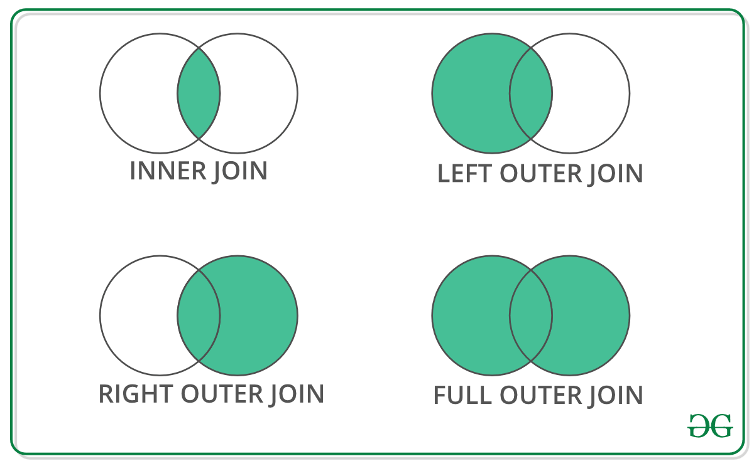
Merging DataFrame
import pandas as pd
data1 = {'key': ['K0', 'K1', 'K2', 'K3'],
'Name':['Jai', 'Princi', 'Gaurav', 'Anuj'],
'Age':[27, 24, 22, 32],}
data2 = {'key': ['K0', 'K1', 'K2', 'K3'],
'Address':['Nagpur', 'Kanpur', 'Allahabad', 'Kannuaj'],
'Qualification':['Btech', 'B.A', 'Bcom', 'B.hons']}
df = pd.DataFrame(data1)
df1 = pd.DataFrame(data2)
print(df, "\n\n", df1)
res = pd.merge(df, df1, on='key’)
res

Slide 24
import pandas as pd
data1 = {'key': ['K0', 'K1', 'K2', 'K3'],
'key1': ['K0', 'K1', 'K0', 'K1'],
'Name':['Jai', 'Princi', 'Gaurav', 'Anuj'],
'Age':[27, 24, 22, 32],}
data2 = {'key': ['K0', 'K1', 'K2', 'K3'],
'key1': ['K0', 'K0', 'K0', 'K0'],
'Address':['Nagpur', 'Kanpur', 'Allahabad', 'Kannuaj'],
'Qualification':['Btech', 'B.A', 'Bcom', 'B.hons']}
df = pd.DataFrame(data1)
df1 = pd.DataFrame(data2)
print(df, "\n\n", df1)
res1 = pd.merge(df, df1, on=['key', 'key1’])
res1

Slide 25
Merging dataframe using how in an argument:
import pandas as pd
data1 = {'key': ['K0', 'K1', 'K2', 'K3'],
'key1': ['K0', 'K1', 'K0', 'K1'],
'Name':['Jai', 'Princi', 'Gaurav', 'Anuj'],
'Age':[27, 24, 22, 32],}
data2 = {'key': ['K0', 'K1', 'K2', 'K3'],
'key1': ['K0', 'K0', 'K0', 'K0'],
'Address':['Nagpur', 'Kanpur', 'Allahabad', 'Kannuaj'],
'Qualification':['Btech', 'B.A', 'Bcom', 'B.hons']}
df = pd.DataFrame(data1)
df1 = pd.DataFrame(data2)
print(df, "\n\n", df1)
res = pd.merge(df, df1, how='left', on=['key', 'key1'])
res

Slide 26
Now we set how = 'right' in order to use keys from right frame only.
res1 = pd.merge(df, df1, how='right', on=['key', 'key1’])
res1
Now we set how = 'outer' in order to get union of keys from dataframes.
res2 = pd.merge(df, df1, how='outer', on=['key', 'key1'])
res2
Now we set how = 'inner' in order to get intersection of keys from dataframes.
res3 = pd.merge(df, df1, how='inner', on=['key', 'key1'])
res3

Slide 27
Joining DataFrame
import pandas as pd
data1 = {'Name':['Jai', 'Princi', 'Gaurav', 'Anuj'],
'Age':[27, 24, 22, 32]}
data2 = {'Address':['Allahabad', 'Kannuaj', 'Allahabad', 'Kannuaj'],
'Qualification':['MCA', 'Phd', 'Bcom', 'B.hons']}
df = pd.DataFrame(data1,index=['K0', 'K1', 'K2', 'K3'])
df1 = pd.DataFrame(data2, index=['K0', 'K2', 'K3', 'K4'])
print(df, "\n\n", df1)
res = df.join(df1)
res

Slide 28
Joining dataframe using on in an argument :
import pandas as pd
data1 = {'Name':['Jai', 'Princi', 'Gaurav', 'Anuj'],
'Age':[27, 24, 22, 32],
'Key':['K0', 'K1', 'K2', 'K3']}
data2 = {'Address':['Allahabad', 'Kannuaj', 'Allahabad', 'Kannuaj'],
'Qualification':['MCA', 'Phd', 'Bcom', 'B.hons']}
df = pd.DataFrame(data1)
df1 = pd.DataFrame(data2, index=['K0', 'K2', 'K3', 'K4'])
print(df, "\n\n", df1)
res2 = df.join(df1, on='Key')
res2

Slide 29
Joining singly-indexed DataFrame with multi-indexed DataFrame :
import pandas as pd
data1 = {'Name':['Jai', 'Princi', 'Gaurav'],
'Age':[27, 24, 22]}
data2 = {'Address':['Allahabad', 'Kannuaj', 'Allahabad', 'Kanpur'],
'Qualification':['MCA', 'Phd', 'Bcom', 'B.hons']}
df = pd.DataFrame(data1, index=pd.Index(['K0', 'K1', 'K2'], name='key'))
index = pd.MultiIndex.from_tuples([('K0', 'Y0'), ('K1', 'Y1'),
('K2', 'Y2'), ('K2', 'Y3')],
names=['key', 'Y'])
df1 = pd.DataFrame(data2, index= index)
print(df, "\n\n", df1)
result = df.join(df1, how='inner')
result

